Slide 1
Equilibrium fast trading
By Bruno Biais, Thierry Focault, Sophie Moinas
Presented by Zongyu Cai
Instructed by Phil Dybivg
Notes:
Hi everyone, the paper I’m gonna talk about is “Equilibrium fast trading”. It is a paper using economic model to explain the value created by fast traders and the corresponding cost.

Slide 2
Agenda
Introduction
Model
Equilibrium allocations and prices – fix alpha
Equilibrium investment in fast technology – endogenize alpha
Social optimum and policy intervention
Conclusion
Personal view
Notes:
First , I’m gonna talk about the agenda.
Second, how to build the model
Third, with a fixed alpha, a parameter measures the percentage of fast traders, what will the equilibrium be
Forth, what is equilibrium alpha
Fifth, what is the social optimum and how can we achieve that social optimum by intervention
Last but not least, my personal view of this paper

Slide 3
Introduction
Investors must process very large amounts of information, in particular about trades and quotes, across different trading venues
Timely collection is difficult and delayed in execution is costly
How to reduce – invest in fast trading technologies,
smarter routers, colocation rights, high speed connections
The information advantage generates adverse selection costs for other market participants – information asymmetry
adverse selection costs: fast traders enlarge the bid-ask spread.
Notes:
Smarter routers: compare quotes across different trading venues and allocate their orders accordingly
Colocation rights: get fast access to the exchange data
High speed connection: the length of fiber optic caples

Slide 4
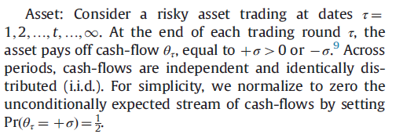
Model

Slide 5
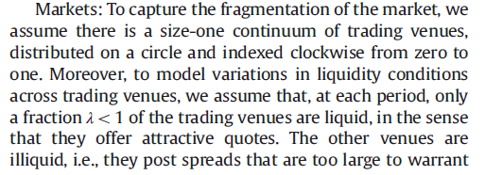
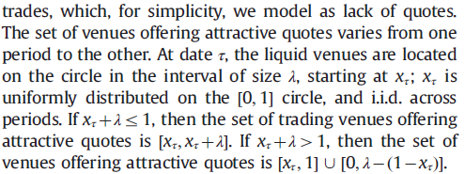
All venues
liquid

Slide 6
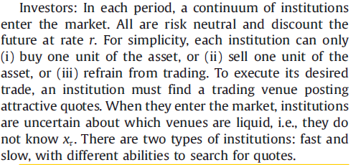

Slide 7

Fast traders
Inspect all trading venues instantaneously and find a liquid one with certainty upon arrival
Observe prices of other assets with payoffs related to $θ_{τ}$
Observe $θ_{τ}$ and $x_{τ}$
fast

Slide 8

Slow traders
Inspect only one trading venue within one period
Randomly choose one to inspect
With probability of $λ$, it is tradable.
Do not observe $θ_{τ}$ and $x_{τ}$
If not find a liquid trading venue, wait(means
keeping slow) until the next period,
with probability $π$
slow

Slide 9

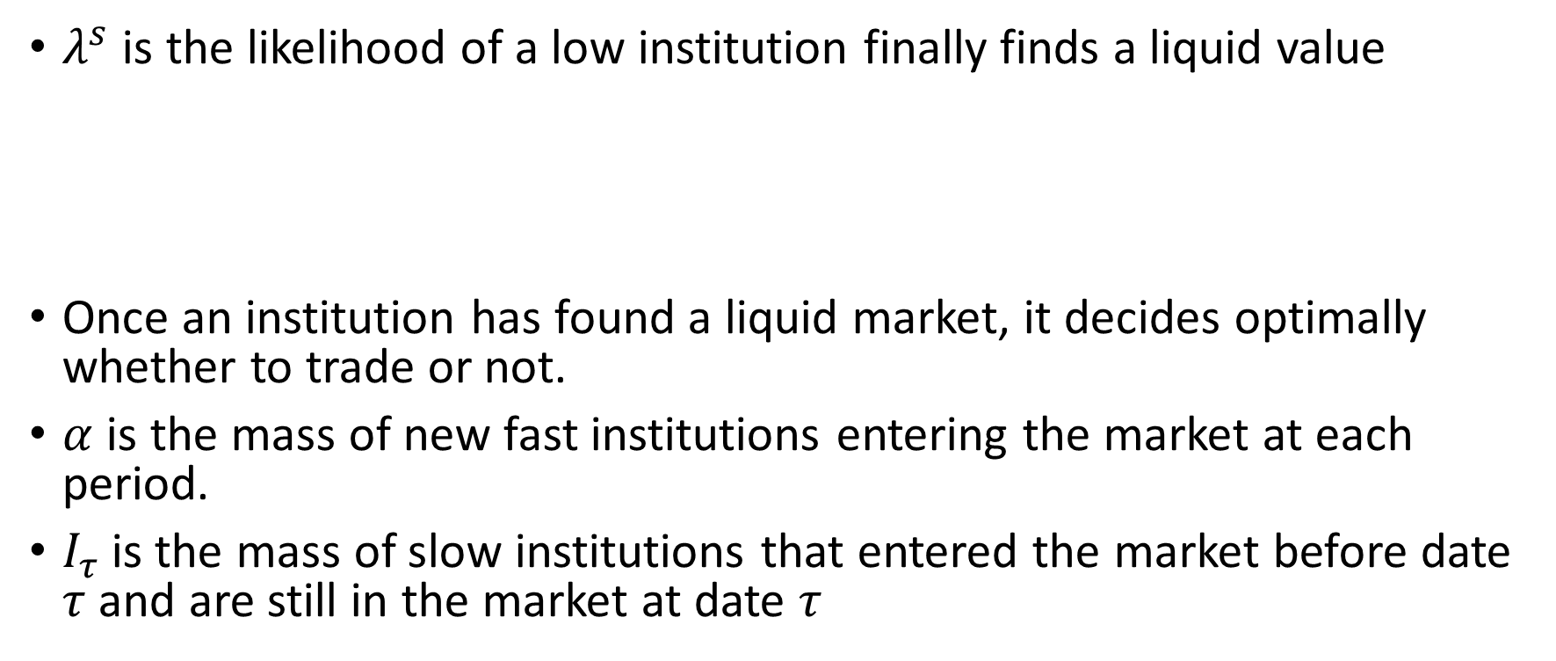
Slow
$λ^{s}$ is the likelihood of a low institution finally finds a liquid value
Once an institution has found a liquid market, it decides optimally whether to trade or not.
$α$ is the mass of new fast institutions entering the market at each period.
$I_{τ}$is the mass of slow institutions that entered the market before date $τ$ and are still in the market at date $τ$

Slide 10



Slow
Stationary level
Stationary regime:
of slow institutions find quotes

Slide 11


Slide 12
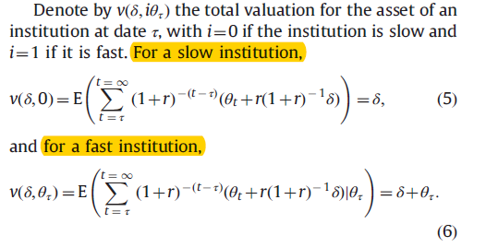

Slide 13
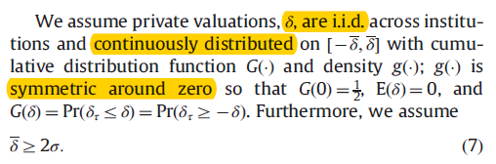

Slide 14
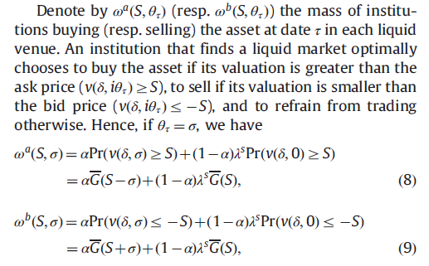
Trading – stationary symmetric equilibra

Slide 15
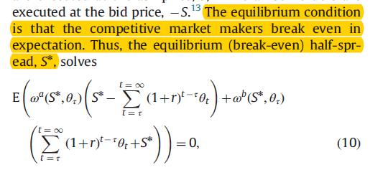
Market maker, Bid-ask spread
Risk-neutral market maker, zero private valuation for the asset

Slide 16
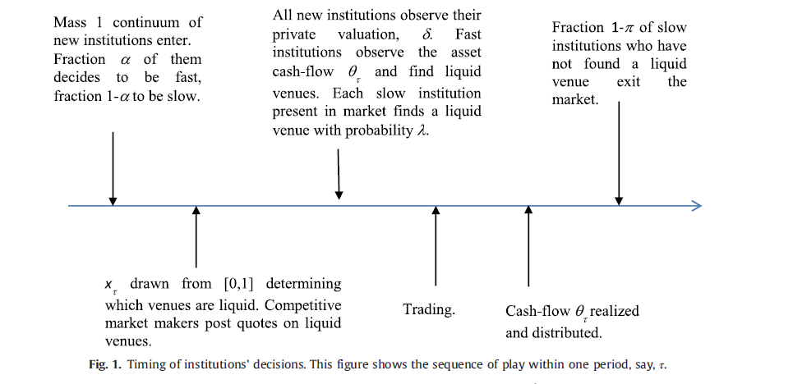

Slide 17
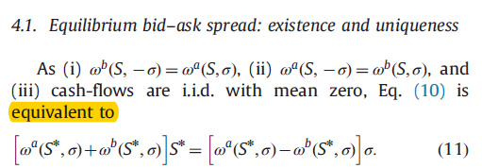
Equilibrium with given alpha
Gross profit of a market maker vs the adverse selection

Slide 18
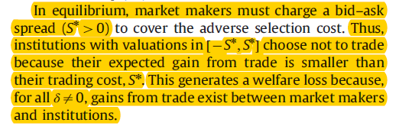

Equilibrium with given alpha
But Does $S^{∗}$ exist ?

Slide 19

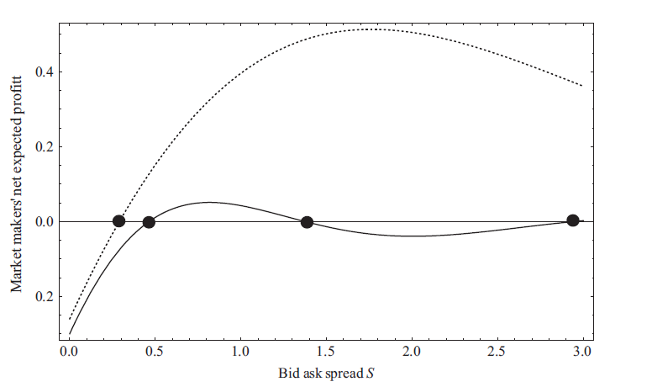
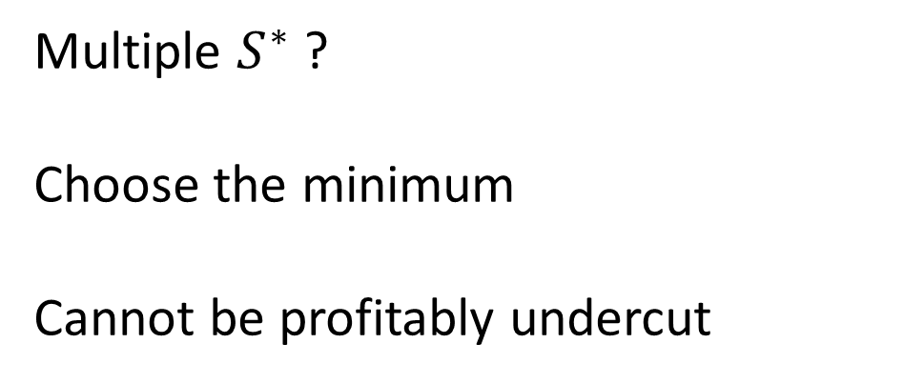
Equilibrium with given alpha
1
Multiple $S^{∗}$ ?
Choose the minimum
Cannot be profitably undercut

Slide 20

Equilibrium with given alpha

Slide 21
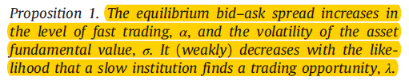
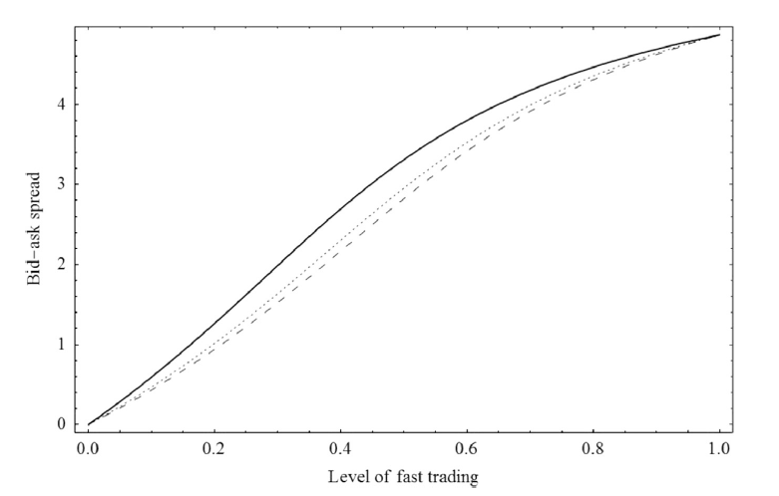
Equilibrium with given alpha

Slide 22
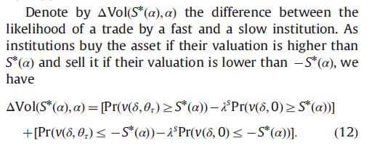
Trading volume

Slide 23
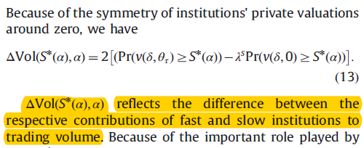
Trading volume

Slide 24
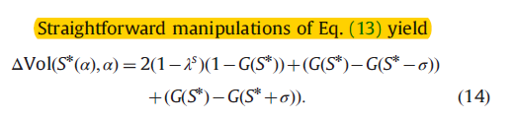

Trading volume
Trigger trading
Prevent trading
More efficient search, Advanced information on cash flows

Slide 25
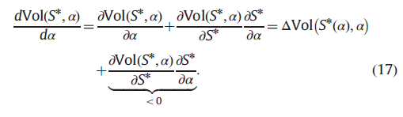
Trading volume

Slide 26
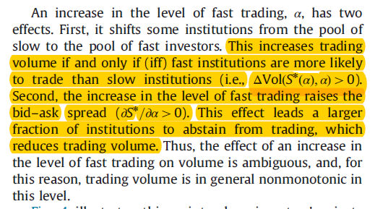
Trading volume

Slide 27
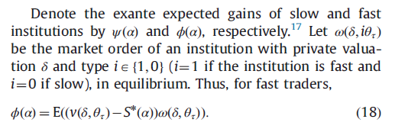
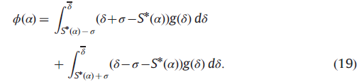
Equilibrium investment – find alpha

Slide 28
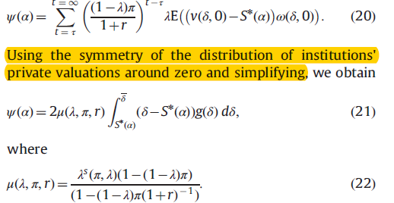
Equilibrium investment – find alpha
$μ:$ reflect delay cost. The cost is high when $r$ is high, $π$ is small, $γ$ is small

Slide 29
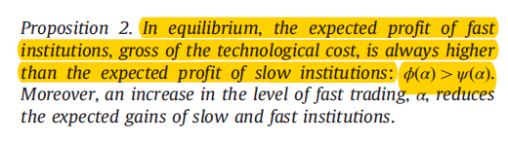
Equilibrium investment – find alpha

Slide 30
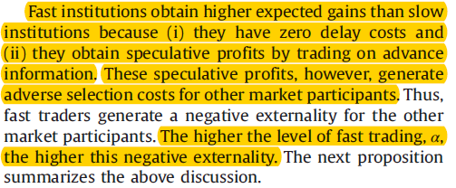
Equilibrium investment – find alpha

Slide 31
Substitutablity or complementarity
Substitute: apple and banan
Complementary: chicken and beer

Slide 32
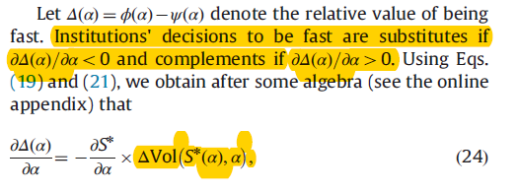
Substitutablity or complementarity

Slide 33
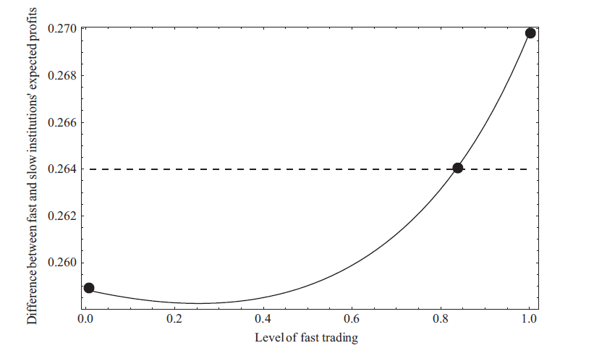
Substitutablity or complementarity
Arms race

Slide 34
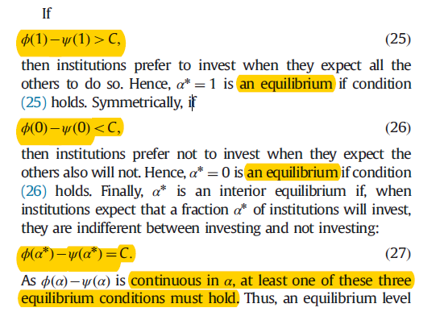
Equilibrium investment – find alpha

Slide 35

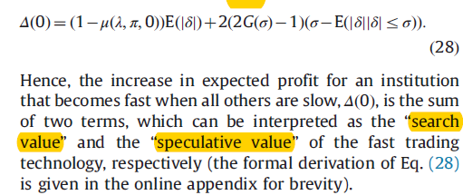
Equilibrium investment – find alpha

Slide 36
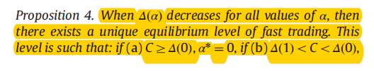

Equilibrium investment – find alpha

Slide 37
Equilibrium investment – find alpha

Slide 38
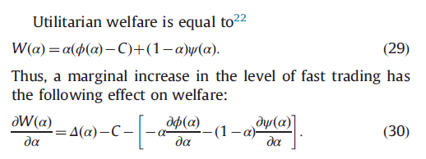
Social optimum and policy intervention

Slide 39
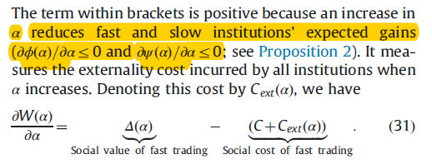
Social optimum and policy intervention

Slide 40

Social optimum and policy intervention

Slide 41
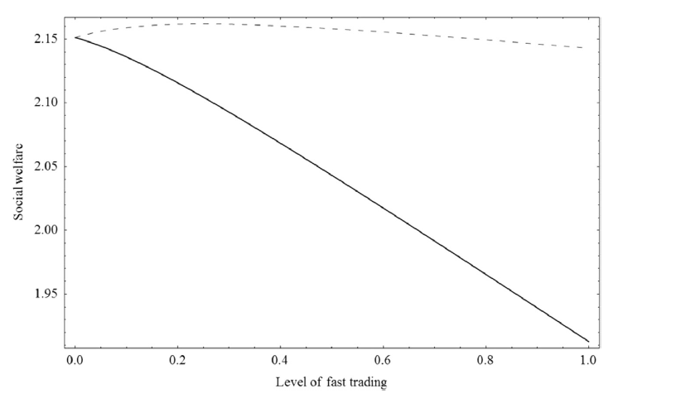

Slide 42
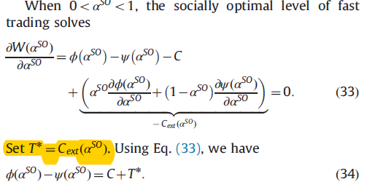
Policy response – Pigovian taxes
Pigovian taxes: for example, pollution tax

Slide 43
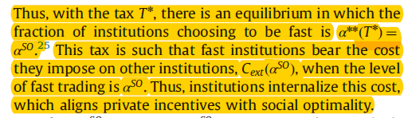
Policy response – Pigovian taxes

Slide 44
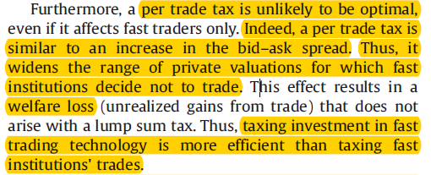
Policy response – Pigovian taxes

Slide 45
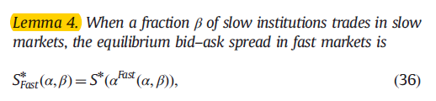
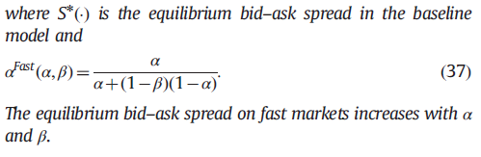
Policy response – Two markets

Slide 46
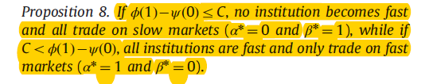
Policy response – Two markets

Slide 47
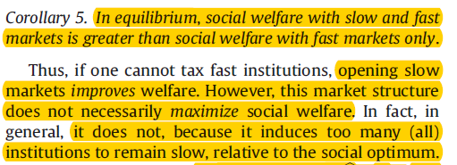
Policy response – Two markets

Slide 48
Conclusion
Investment in fast trading tech helps financial institutions cope with market fragmentation. It improves social welfare
Fast trading tech also creates adverse selection cost. It lowers social welfare. Thus, it generates a negative externality
Complements – arms race
Slow-only market: improve social welfare, but not the maximum
Pigovian tax: social optimal level

Slide 49
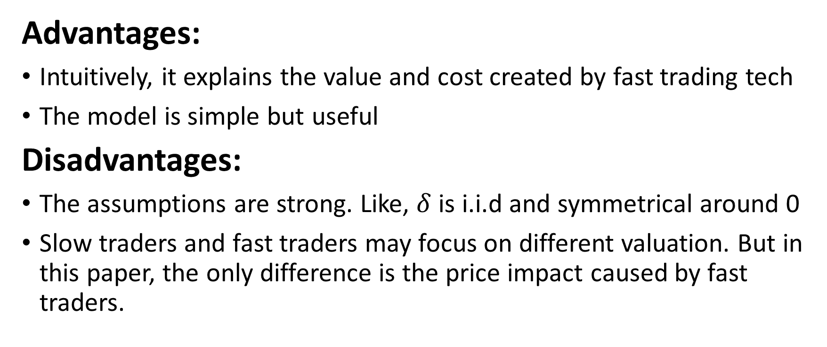
My view
Advantages:
Intuitively, it explains the value and cost created by fast trading tech
The model is simple but useful
Disadvantages:
The assumptions are strong. Like, $δ$ is i.i.d and symmetrical around 0
Slow traders and fast traders may focus on different valuation. But in this paper, the only difference is the price impact caused by fast traders.

Slide 50
My view
Furthermore, the assumption that “once an institution has found a liquid market, it decides optimally whether to trade or not” may not hold for all investors.
Therefore, the paper is talking about the relationship between fastest traders and traders who are not so fast but still faster than common investors who invest in the long run.
So an important thing is that there are Speed Hierarchies in the real world, which will make it more complicated to figure out the relationship

